Slide 1

COMPUTER NETWORKS
Sivaraman Eswaran Ph.D.
Department of Computer Science and Engineering

Slide 2

COMPUTER NETWORKS
Application Layer
Sivaraman Eswaran Ph.D.
Department of Computer Science and Engineering

Slide 3
COMPUTER NETWORKS
Unit – 2 Application Layer
2.1 Principles of Network Applications
2.2 Web, HTTP and HTTPS
2.3 The Domain Name System
2.4 P2P Applications
2.5 Socket Programming with TCP & UDP
2.6 Other Application Layer Protocols

Slide 4


COMPUTER NETWORKS
Web Caches (Proxy Servers)
Goal: satisfy client request without involving origin server
user configures browser to point to a Web cache
browser sends all HTTP requests to cache
if object in cache: cache returns object to client
else cache requests object from origin server, caches received object, then returns object to client
proxy
server
HTTP request
HTTP request
client
HTTP response
HTTP response
origin
server
HTTP request
HTTP response
client
origin
server

Slide 5
COMPUTER NETWORKS
Web Caches (Proxy Servers)
Web cache acts as both client and server
server for original requesting client
client to origin server
typically cache is installed by ISP (university, company, residential ISP)
Why Web caching?
reduce response time for client request (speed)
cache is closer to client
reduce traffic on an institution’s access link (saves bandwidth)
internet is dense with caches
enables “poor” content providers to more effectively deliver content
privacy – surf the internet anonymously
activity logging

Slide 6

COMPUTER NETWORKS
Caching example
(15 req/sec) * (100 Kbits/req)/(1.54 Mbps) = 0.974
(15 req/sec) * (100 Kbits/req)/(1 Gbps) = 0.0015
Scenario:
access link rate: 1.54 Mbps
RTT from institutional router to server: 2 sec
Web object size: 100K bits
Average request rate from browsers to origin servers: 15/sec
average data rate to browsers: 1.50 Mbps
origin
servers
public
Internet
1.54 Mbps
access link
Performance:
LAN utilization: .0015
access link utilization = .97
end-end delay = Internet delay +
access link delay + LAN delay
= 2 sec + minutes + usecs
problem: large delays at high utilization!
institutional
network
1 Gbps LAN

Slide 7
COMPUTER NETWORKS
Caching example: buy a faster access link
Scenario:
access link rate: 1.54 Mbps
RTT from institutional router to server: 2 sec
Web object size: 100K bits
Avg request rate from browsers to origin servers: 15/sec
avg data rate to browsers: 1.50 Mbps
154 Mbps
origin
servers
public
Internet
154 Mbps
1.54 Mbps
access link
Performance:
LAN utilization: .0015
access link utilization = .97
end-end delay = Internet delay +
access link delay + LAN delay
= 2 sec + minutes + usecs
institutional
network
.0097
1 Gbps LAN
Cost: faster access link (expensive!)
msecs

Slide 8
COMPUTER NETWORKS
Caching example: install a web cache
Scenario:
access link rate: 1.54 Mbps
RTT from institutional router to server: 2 sec
Web object size: 100K bits
Avg request rate from browsers to origin servers: 15/sec
avg data rate to browsers: 1.50 Mbps
origin
servers
public
Internet
1.54 Mbps
access link
institutional
network
Performance:
LAN utilization: .?
access link utilization = ?
average end-end delay = ?
How to compute link
utilization, delay?
1 Gbps LAN
local web cache
Cost: web cache (cheap!)

Slide 9
COMPUTER NETWORKS
Caching example: install a web cache
Calculating access link utilization, end-end delay with cache:
suppose cache hit rate is 0.4: 40% requests satisfied at cache, 60% requests satisfied at origin
origin
servers
public
Internet
access link: 60% of requests use access link
data rate to browsers over access link
= 0.6 * 1.50 Mbps = .9 Mbps
utilization = 0.9/1.54 = .58
1.54 Mbps
access link
institutional
network
average end-end delay
= 0.6 * (delay from origin servers)
+ 0.4 * (delay when satisfied at cache)
= 0.6 (2.01) + 0.4 (~msecs) = ~ 1.2 secs
1 Gbps LAN
local web cache
lower average end-end delay than with 154 Mbps link (and cheaper too!)

Slide 10
COMPUTER NETWORKS
Conditional Get
client
server
Goal: don’t send object if cache has up-to-date cached version
no object transmission delay
lower link utilization
cache: specify date of cached copy in HTTP request
If-modified-since: <date>
server: response contains no object if cached copy is up-to-date:
HTTP/1.0 304 Not Modified
HTTP request msg
If-modified-since: <date>
object
not
modified
before
<date>
HTTP response
HTTP/1.0
304 Not Modified
HTTP request msg
If-modified-since: <date>
object
modified
after
<date>
HTTP response
HTTP/1.0 200 OK
<data>

Slide 11
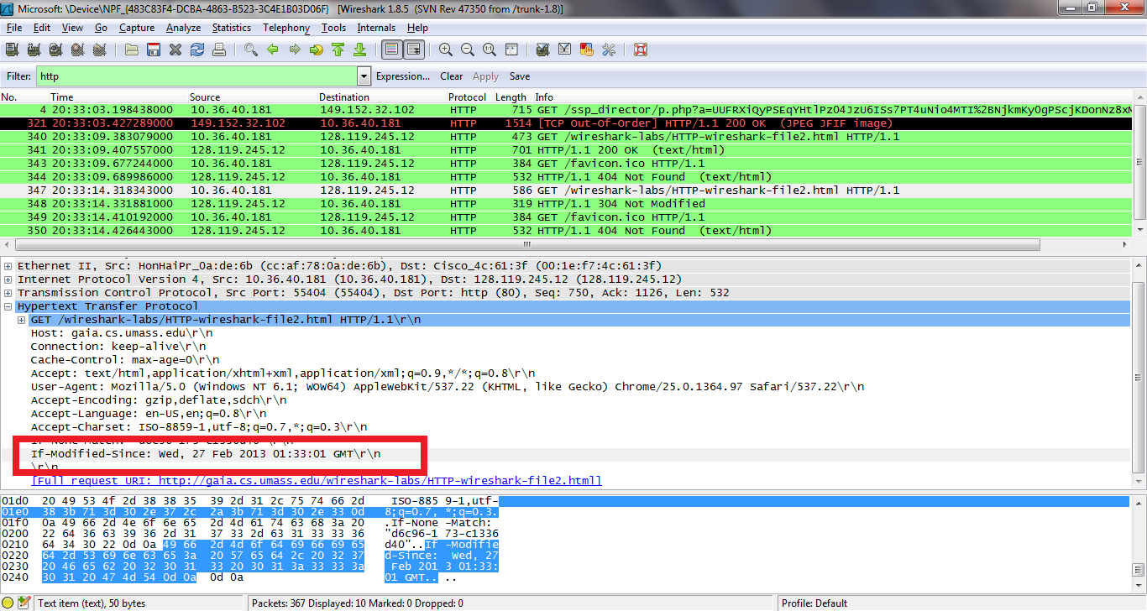
COMPUTER NETWORKS
Conditional Get (more)

Slide 12
THANK YOU
Sivaraman Eswaran Ph.D.
Department of Computer Science and Engineering
sivaramane@pes.edu
+91 80 6666 3333 Extn 834

